Slide 1
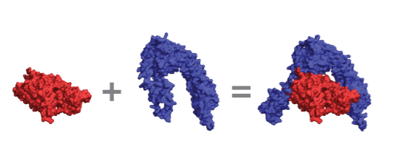
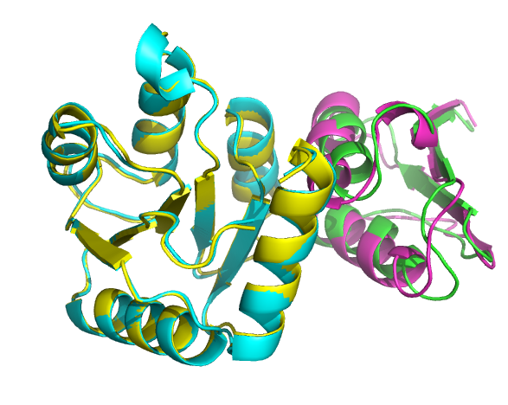
Predicting Protein-Protein Interface Using 3D-CNN
(Flexible 3D Jigsaw Puzzle)
Gundeep Singh
Biophysics Field
Nov 9, 2020
Rotation Talk
Yu Lab

Slide 2
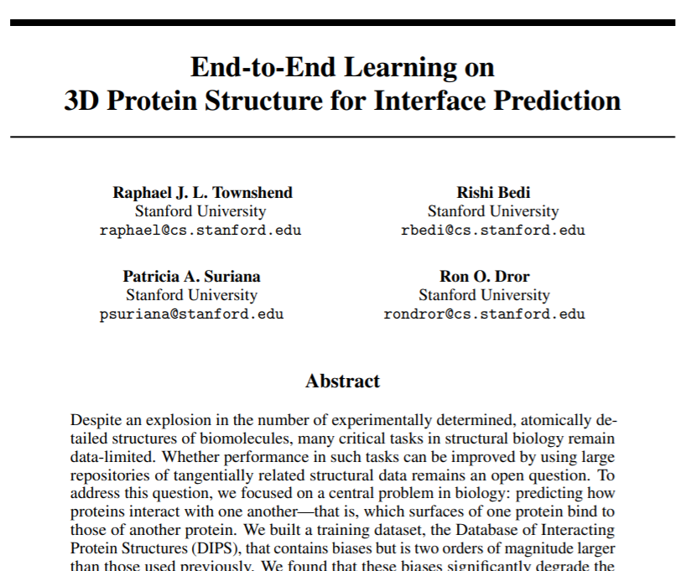
Motivation and Goal
Goal: Given separate structures of two proteins, Want to predict which surfaces of the two proteins will come into contact upon binding
Workflow: Using PDB files of paired protein structures, train an ML model on atomic coordinates, transformed into 3D images, to make interface predictions.
Novelty: Only uses spatial coordinates and identities of atoms as inputs, instead of relying on hand-crafted features
Motivation: Potential applications in protein engineering and drug development.
Want to implement a 3D CNN model described in this paper.
Notes:
Only uses spatial coordinates and identities of atoms as inputs, instead of relying on hand-crafted features

Slide 3
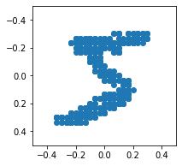
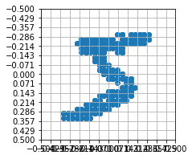
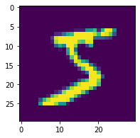
Pixelization - 2D MNIST
Pixelization: Transforming 2D coordinates into 2D images
Magnitude of each pixel depends on the amount of ‘signal’ received
Notes:
To understand this transformation of 3d coordinates into 3D images, let’s talk about something simpler - 2D. This can be done using this concept of pixelization
Modified National Institute of Standards and Technology or Modified NIST or MNIST Database

Slide 4
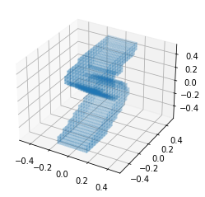
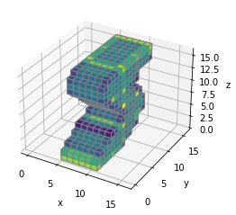
Voxelization - 3D MNIST
Point Cloud (xyz data) to a 16x16x16 3D Image
Face colors of voxels correspond to number of points inside each voxel

Slide 5
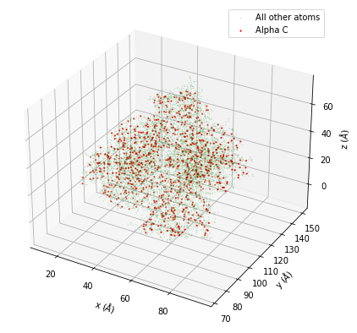
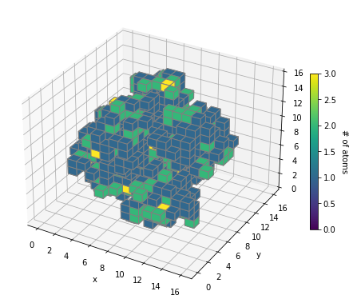
Voxelization - PDB Protein
Alpha-C

Slide 6
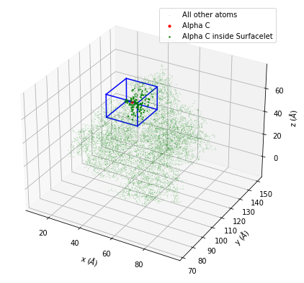
Voxelized Surfacelet
Surfacelet: Cubic box of dimension bxbxb (in Å³) with Alpha-C of interest at its center.
All atoms of the protein that lie inside the surfacelet are considered as points to voxelized.
Voxelgrid is chosen to be of dimension bxbxb, such that each voxel is 1Å³ in volume, and consists of ~1 atom.
20 Å
Notes:
But we are not interested in the full protein structure. We are interested in whether subparts of the protein are involved in interaction. Such subparts are described using the concept of surfacelets.
Very rarely >1 atoms (<0.5%). At most 2 - but again, a fairly rare event.

Slide 7
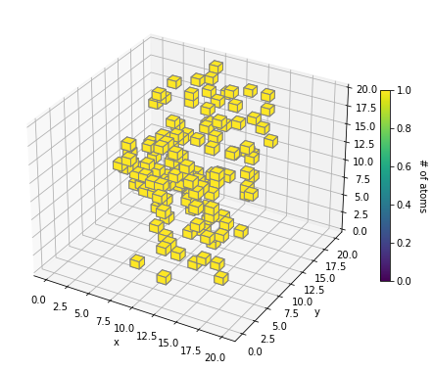
Voxelized Surfacelet
20 Å

Slide 8
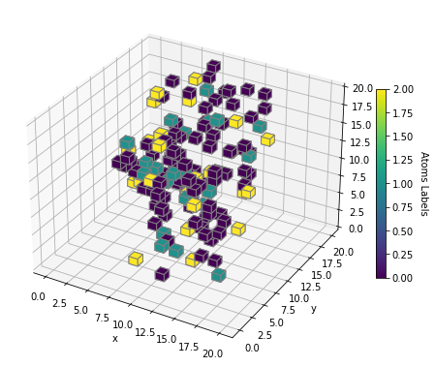
Voxelized Surfacelet
20 Å
Key for Atom Labels: 0=‘C’, 1=‘N’, 2=‘O’, 3=‘S’

Slide 9
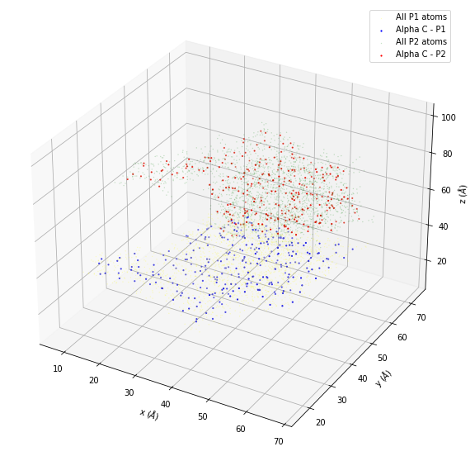
Pairwise Interaction
We are interested in how a pair of proteins interact.
Use complex bound structures to extract information about how surfacelets interact.

Slide 10
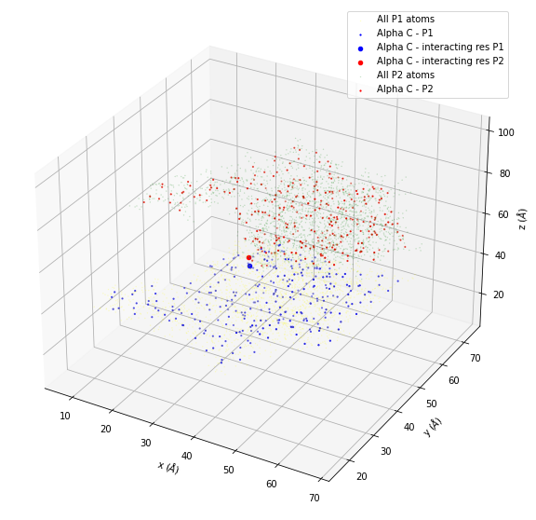
Pairwise Interaction
Two residues R₁ from protein P₁ and R₂ from protein P₂ are said to be in an interacting pair if:
At least one atom of R₁ is < 6 Å from an atom of R₂.

Slide 11
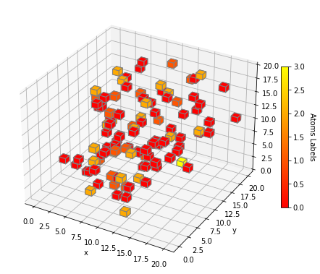
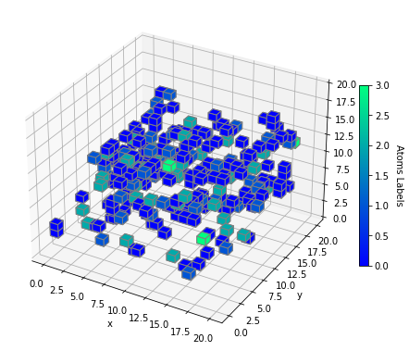
Key for Atom Labels: 0=‘C’, 1=‘N’, 2=‘O’, 3=‘S’

Slide 12

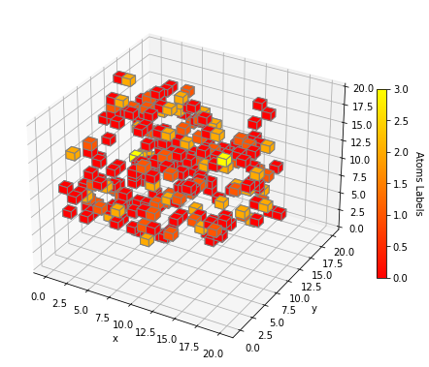
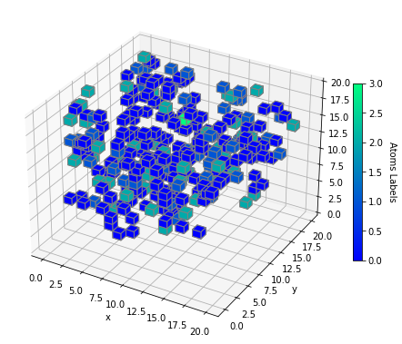
Key for Atom Labels: 0=‘C’, 1=‘N’, 2=‘O’, 3=‘S’

Slide 13
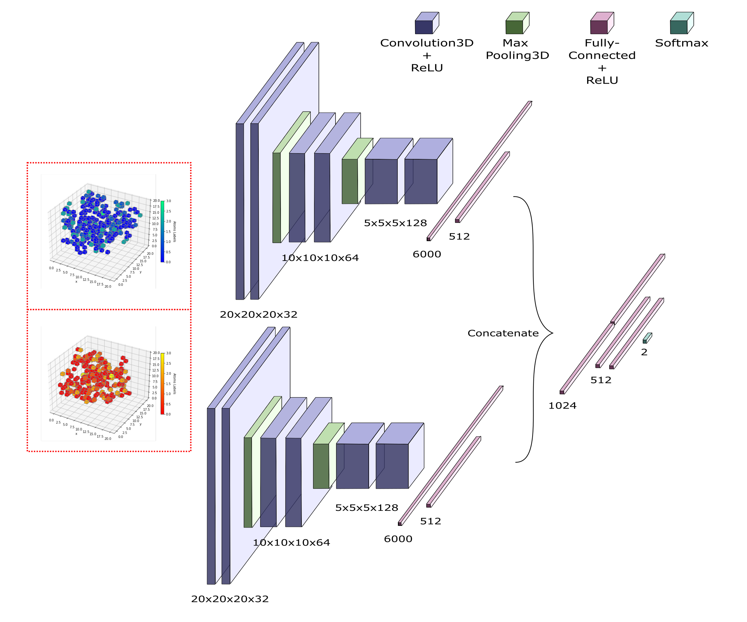

Slide 14
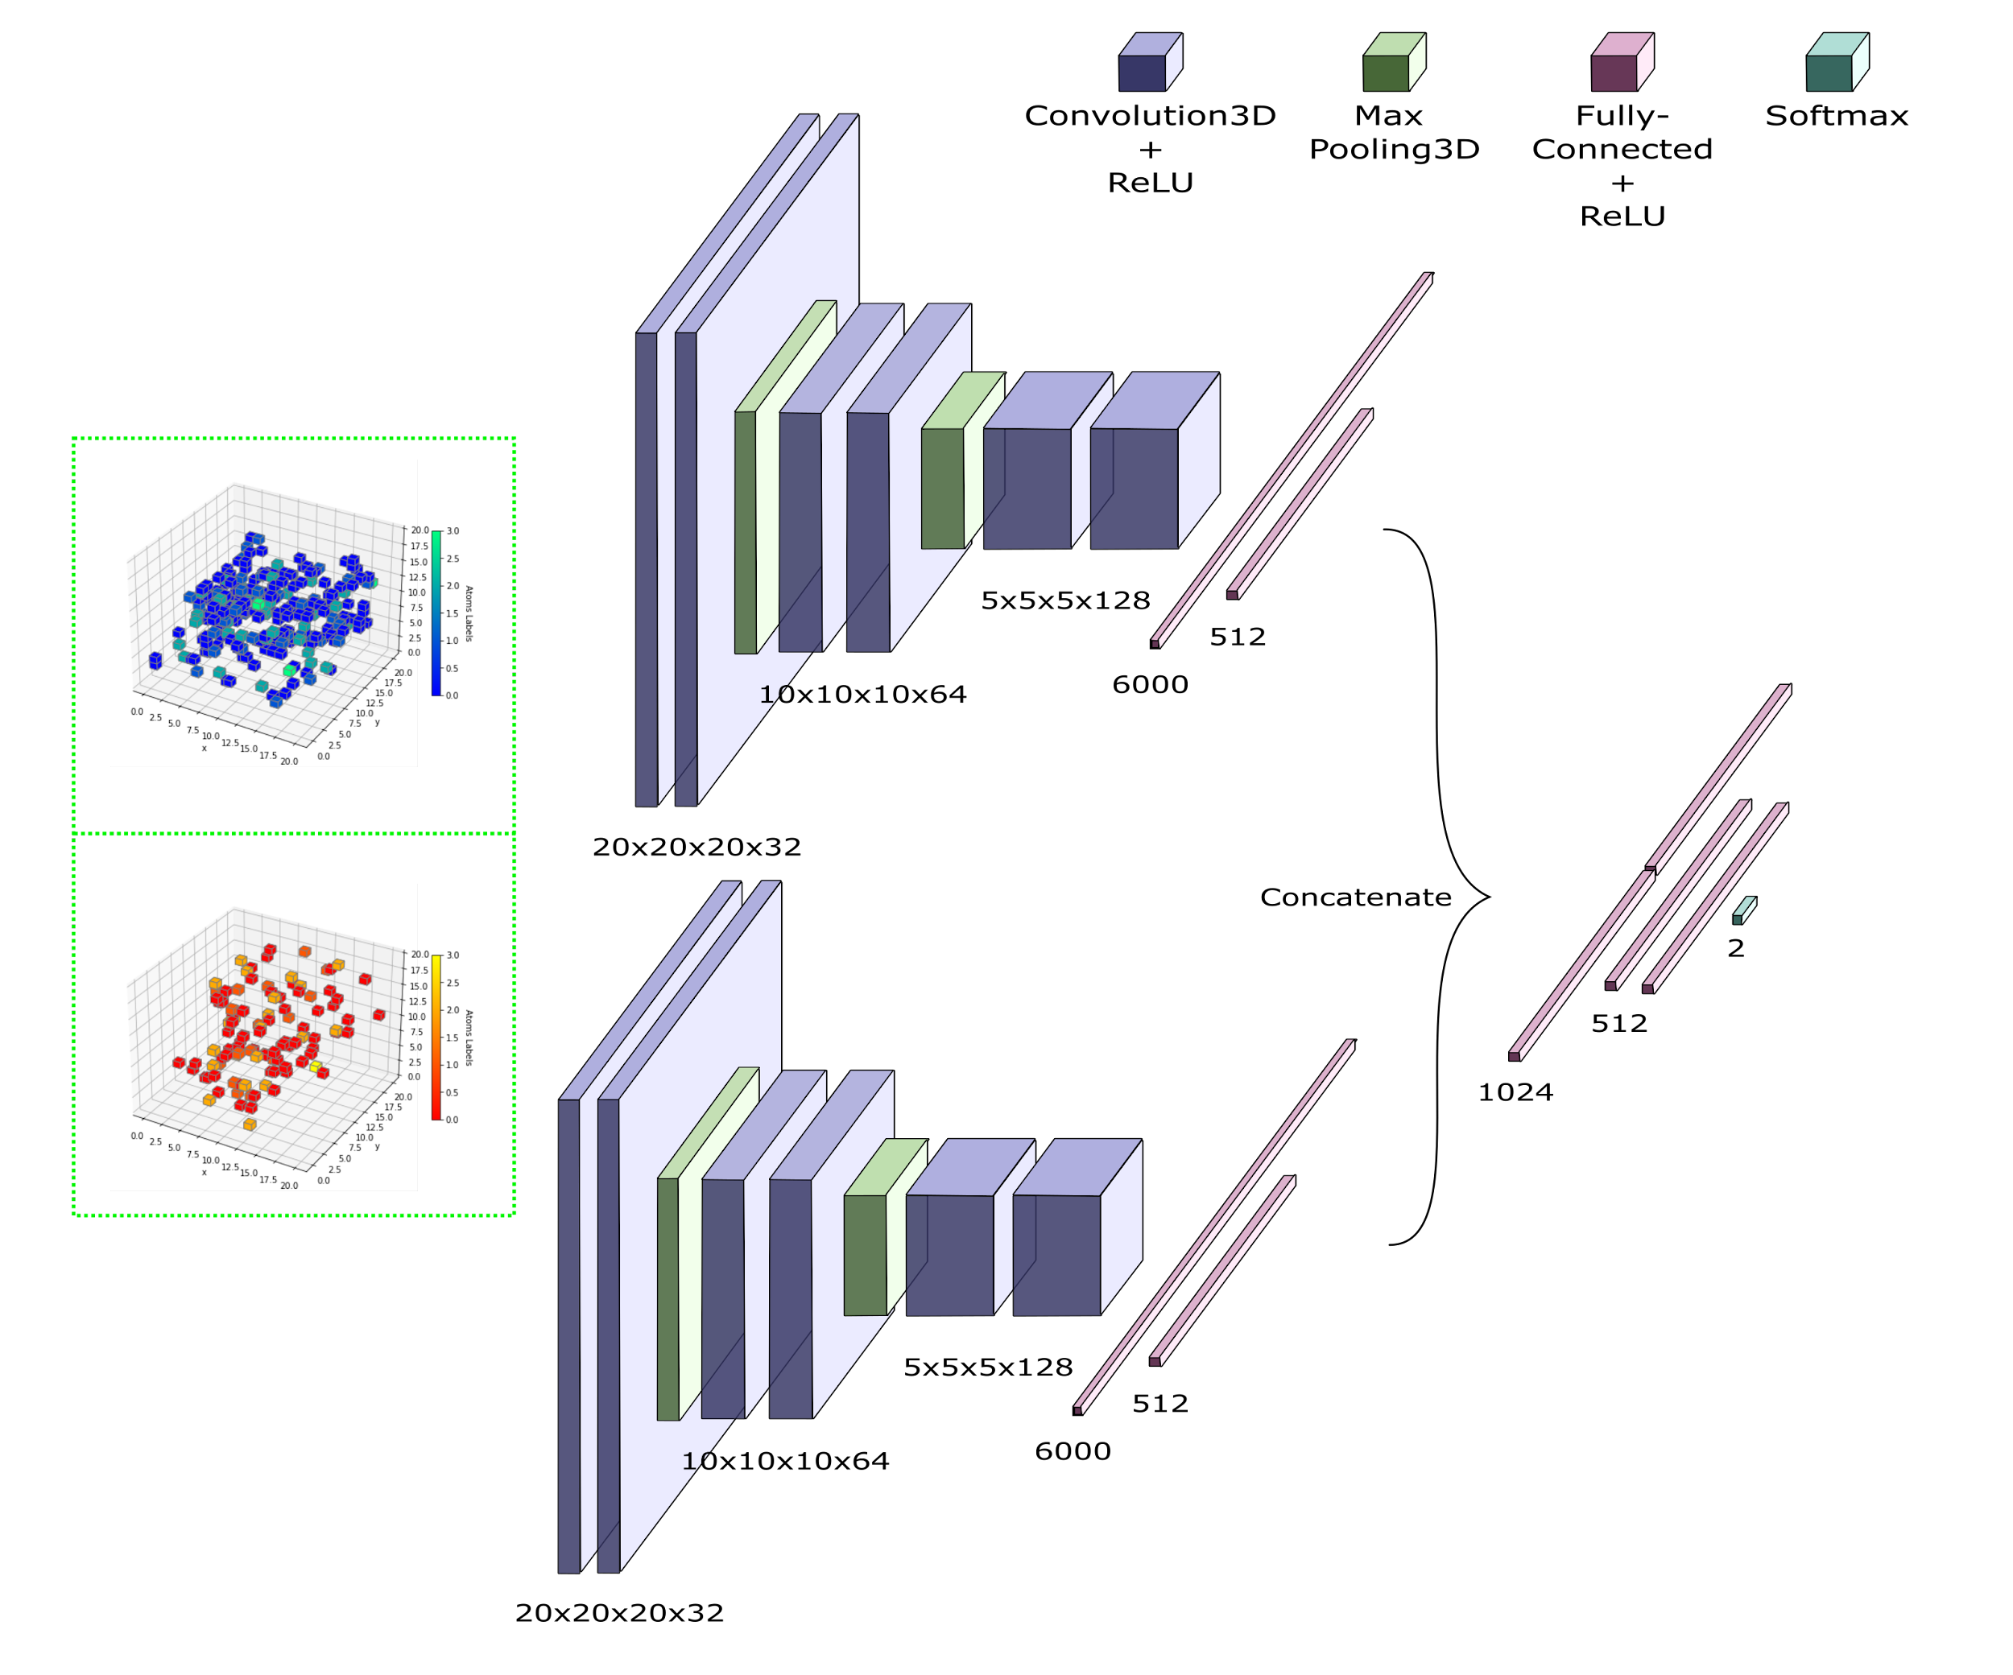

Network Architecture
Name: Siamese Atomic Surfacelet Network (SASNet)
Struc: Pair of inputs provided in two parallel CNN branches with ‘shared’ weights.
Final encoded layers are concatenated together to make prediction.

Slide 15

Network Architecture
Name: Siamese Atomic Surfacelet Network (SASNet)
Struc: Pair of inputs provided in two parallel CNN branches with ‘shared’ weights.
Final encoded layers are concatenated together to make prediction.

Slide 16
Training Data Properties
Total number of protein complexes structures | 1,088
Total number of positive voxelized surfacelet pairs | 80,187 | Σ = 160,374 pairs
Total number of negative voxelized surfacelet pairs | 80,187

Slide 17
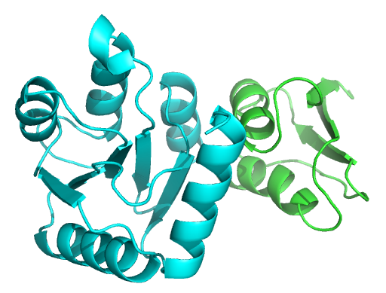
Model Performance
Divide training set into:
Training: 80%, Validation: 10%, Testing: 10%
Testing Accuracy = 84.69%
Cartoon schematic of BNI1 protein (blue) binding to actin (red). Notice how BNI1 opens up to improve its binding affinity to red.
More relevant performance evaluation:
Docking Benchmark 5 (DB5) dataset:
Total Number of Complexes = 55 (of 230)
Testing Accuracy on unbound proteins of DB5 = 72.16%
Chains of PDB ID 1FFW complex unbound and bound

Slide 18
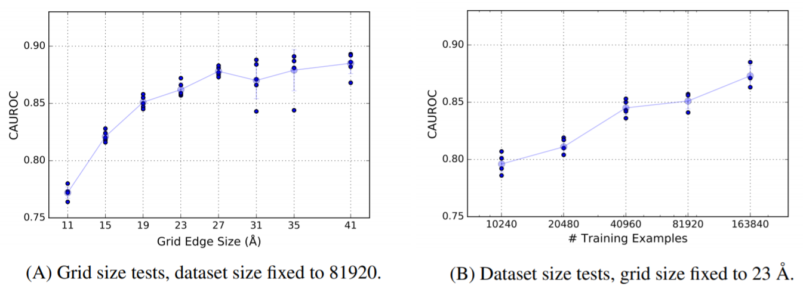
Model Performance
Divide training set into:
Training: 80%, Validation: 10%, Testing: 10%
Testing Accuracy = 84.69%
More relevant performance evaluation:
Docking Benchmark 5 (DB5) dataset:
Total Number of Complexes = 55 (of 230)
Testing Accuracy on unbound proteins of DB5 = 72.16%
80% of 160,374 = 128,300
Notes:
Additional Note: They only test on 55 complexes in DB5. We test for 230. So there might be a some accuracy differences there too.

Slide 19
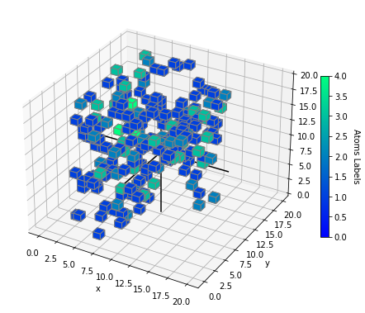
Current/Future Work:
Rotational Invariance
θ_{z}
θ_{y}
Randomly rotate the voxelized surfacelets around the 3 axes with angles {θ_{x},θ_{y},θ_{z}} every epoch.
Finally test the DB5 dataset using median of 20 randomly-rotated surfacelet predictions.
θ_{x}
Key for Atom Labels: 1=‘C’, 2=‘N’, 3=‘O’, 4=‘S’

Slide 20
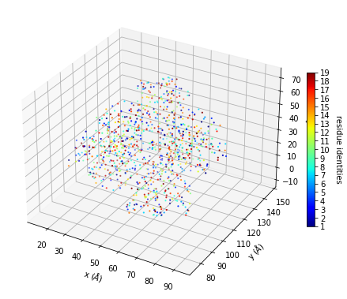
Current/Future Work:
Residue Scale
SASNet works on an atomic scale. That is it uses Atomic Distances (xyz) and Atomic Identities (C,N,O,S).
What if we work at residue scale. That is use Residue Distances (xyz of Cα) and Residue Identities (ALA, ARG, ASN,...).
Advantages: May give us better predictions (scale matters) and less data information needed.
Key for Res Labels: 1=‘ALA’, 2=‘ARG’, 3=‘ASN’, 4=‘ASP’,...

Slide 21
Acknowledgement
Dongjin, Charles, Shayne and rest of Yu Lab
Original Authors of SASNet
Bloggers at Medium, Stackexchange, TowardsDataScience

Slide 22
Supplemental Slides

Slide 23
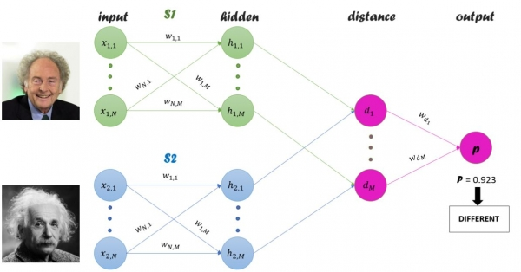
Siamese Network
‘Siamese’ = twin (Indonesia)
Used in
1. Face Recognition
2. One-Shot Training
Instead of similarity,
want complementarity.

Slide 24
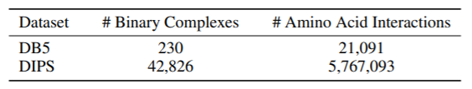
Datatype: Tensorflow Records
One Tensorflow file: 64 proteins complexes
Stanford folks have provided 17 tfrecord files: 17x64 = 1,088 complexes
A datatype for storing sequence of binary records in an efficient serialized manner.

Slide 25
Computational Resources Utilized
Disk Storage: Each 20x20x20x4 file is 256 KB
⇒ (160,374x2) x 256kb ≃ 82 GB
GPU RAM memory: 30 GB
Time needed for 10 epochs: ~ 2 days (NVIDIA Tesla P100)

Slide 26
Criteria for Choosing Complexes
≥ 500 Å² buried surface area
Solved using X-ray crystallography or cryo-electron microscopy at better than 3.5 Å resolution
Only contains protein chains longer than 50 amino acids
Is the first model in a structure

Slide 27
Present Issues
Implementing Rotational Invariance
DB5 test complexes - Positive and Negative classes are still balanced. Not sure where the remaining negative labels are
Hyperparameters of 3D-CNN not optimized. Need to include Batch Normalization
CAUROC (median-per Complex AUROC)
.

Slide 28
Advantages of Using 3D-CNN
Captures the structural hierarchy of proteins
Does not need hand-crafted features, that may introduce biases
Potential significant in improvement in future - Transfer Learning using 3D-ImageNet models

